Slide 1

Self-Harm and Suicide Ideation On Reddit
By
Prasad Vichare, Krutika Kulkarni, Jonathan Huynh,
Sheida Hassani

Slide 2
Abstract
Our Team analysed self-harm and suicide ideation on Reddit by scraping the data from the r/suicideWatch subreddit, focusing on the Emotional analysis of user behaviour.
This Project leverages prompt-based feature extraction using large language models (LLMs) to capture variables based on the scientific instruments.
We investigate whether users' emotional states change over time based on their engagement with coping mechanisms and treatment interventions.
Our findings show that both coping mechanisms and treatments are associated with meaningful changes in emotional patterns over time.

Slide 3





Project Objectives
Extract Emotion Dynamics
Assess Emotional Fluctuations
To extract emotion dynamics using LLM-based prompts and quantify changes like increase emotional ratios and instability.
To assess whether frequent emotional fluctuations (instability) are linked to specific mental health traits.
Explore Demographic Differences
Map Emotional Trajectories
To explore demographic differences in suicide ideation and emotional response using gender and age group segmentation.
To map users as emotionally improved or declined based on longitudinal emotion trends
Analyze Temporal Changes
To analyze how users' emotions change over time based on their use of coping mechanisms and treatment interventions.

Slide 4
Data Sources and Instruments
Primary Data Source
Scientific Instruments
Technical Tools
Reddit data from Academic Torrents
The Columbia-Suicide Severity Rating Scale (C-SSRS)
LLM Used- Google Gemini
Roberta based Emotional Score
Self-Injurious Thoughts and Behaviors Interview (SITBI)
Diagnostic and Statistical Manual of Mental Disorders (DSM-V)

Slide 5

Dataset Overview
84,798
225,185
Unique Users
Total Posts
Individual Reddit accounts analyzed
Combined posts and comments analyzed
25
Features
Data points extracted per user
We extracted features from every post and comment into individual CSV rows, then aggregated those rows by user.

Slide 6
Feature List
AuthorID
Main_Post_ID
Comment_ID
Timestamp
NumComments
Score
PreparatoryPlanMentioned
SelfHarmOrSuicidalThoughtsMentioned
SuicidalOrNSSIMethods
ReasonBehindSuicideNSSI
MentalIllnessTraits
TreatmentMechanism
AttemptedSuicide
AbortedAttempt
ReasonForAbortedAttempt
InterruptedAttempt
ReasonForInterruptedAttempt
OccupationStatus
Gender
AgeGroup
RiskOfSuicideAttempt
SentimentScore
EmotionalScore
SuicidalIdeationTemporalFocus
CopingMechanismTreatmentTemporalFocus

Slide 7
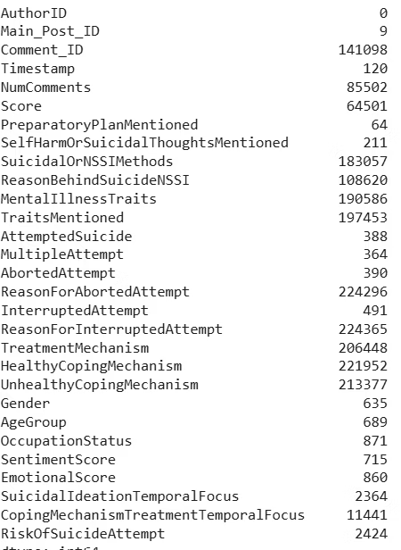
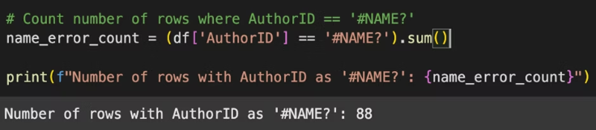
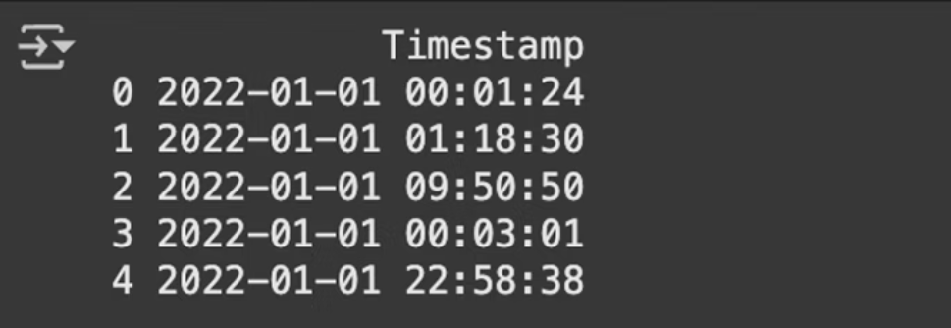
Data Cleaning
After data cleaning, we identified 84,798 unique users with a total of 225,185 rows of data. Out of these users, 78,515 (approximately 92.59%) mentioned self-harm or suicidal thoughts at least once in their posts or comments.

Slide 8
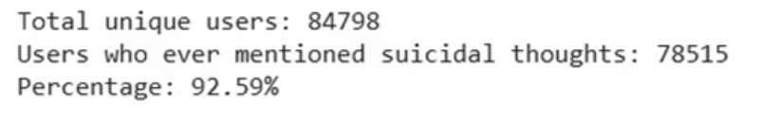
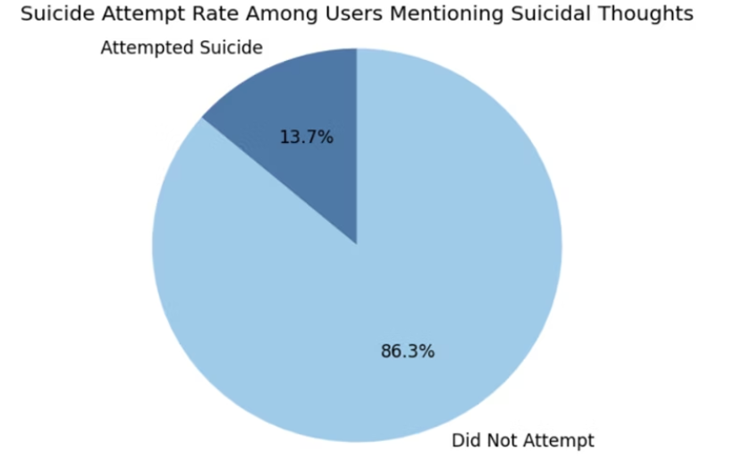
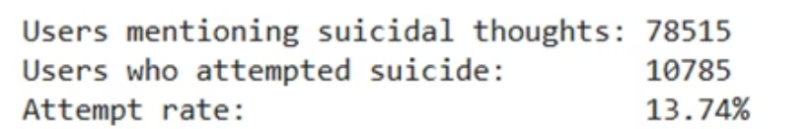
How many users have ever mentioned suicidal or NSSI thoughts?
Out of 84798 total users, 78515 (≈92.59%) mentioned self-harm or suicidal thoughts at least once
How many actually attempted at least once?

Slide 9
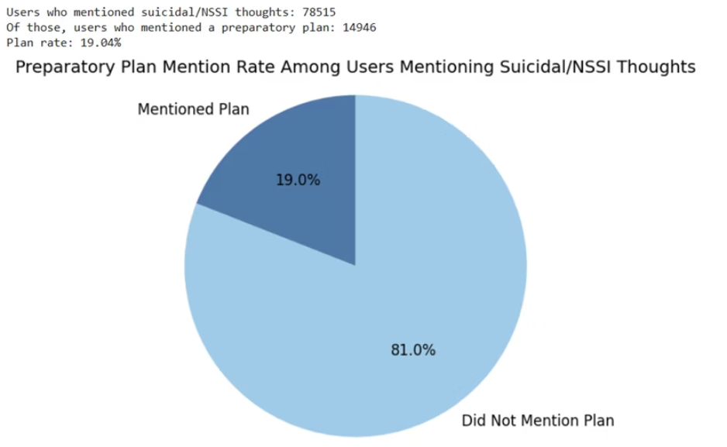
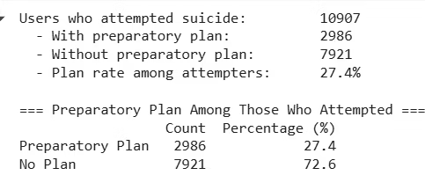
How many mentioned preparatory behaviour?
Out of users who attempted suicide, how many have a preparatory plan?
Only about one in four users who attempted suicide (27.4%) had mentioned a preparatory plan beforehand, while nearly three-quarters (72.6%) did so without any indicated planning.

Slide 10
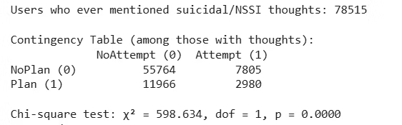
Is planning behaviour significantly associated with attempts?
• No‐plan group: 7805 of 63569 users (~12.27%) went on to attempt suicide
• Plan group: 2980 of 14946 users (~19.93%) went on to attempt suicide
• χ²(1) = 598.634, p < .0001 ⇒ reject H₀ (planning and attempt are independent)
• Conclusion: preparatory planning is significantly associated with an increased risk of later suicide attempt

Slide 11
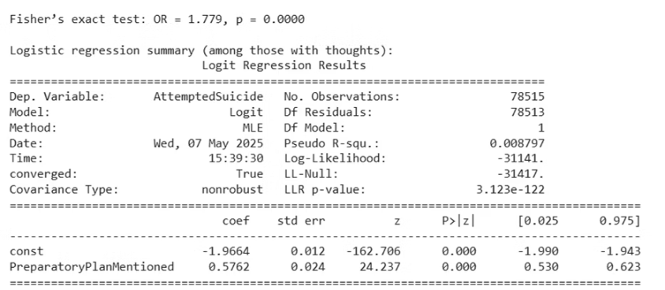



Is planning behaviour significantly associated
with attempts?
Planning as Risk Marker
Planning behavior is a significant
risk marker
Low Predictive Power
Pseudo R² of only 0.008
Multiple Factors
Many other factors contribute to
attempt risk
Odds Ratio (OR) of 1.77 means that among those with suicidal/NSSI thoughts, the odds of attempting suicide are about 77% higher if you reported having a preparatory plan vs. not. Fisher’s p-value < .0001 again confirms this association is highly unlikely to be due to chance
With a Pseudo R² of only 0.008, planning alone is far from a complete risk model—it’s an important risk marker, but many other factors
contribute to who will attempt

Slide 12
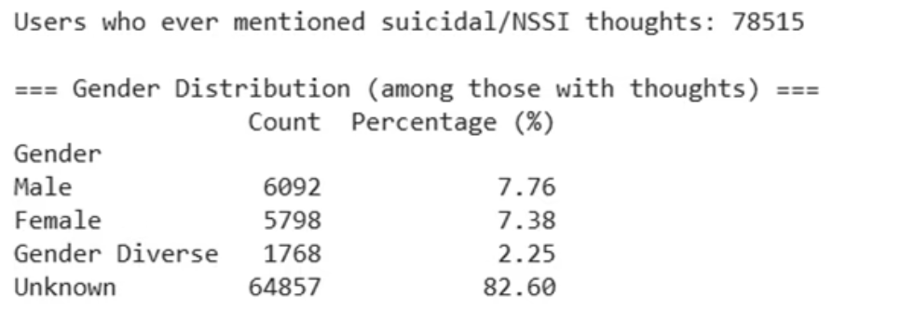
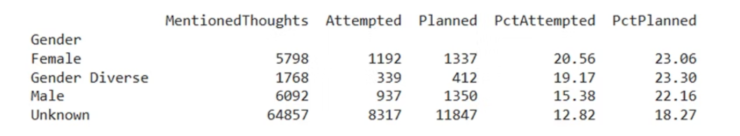
Suicide Preparatory Planning across Gender
This presentation examines suicide preparatory planning, attempt patterns, methods, and motivating factors across different demographic groups, with a focus on gender and age differences.

Slide 13
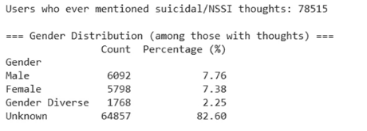
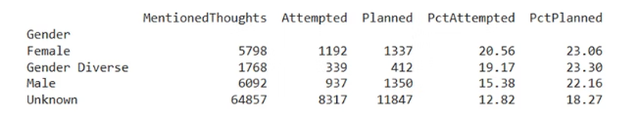
Suicide Preparatory Planning across Gender
- In every group, a higher share reported planning than attempting
- Gender‐diverse users show the highest propensity to plan (23.3%), though their attempt rate (19.17%) trails females (20.0%).
- Females have the highest attempt rate despite lower planning than gender‐diverse and male users.

Slide 14
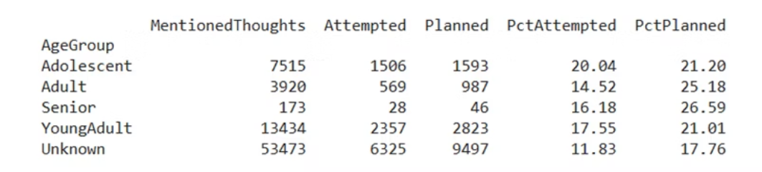
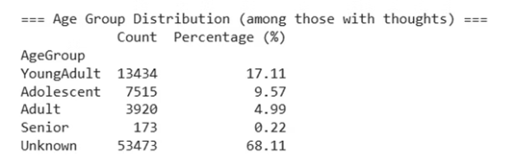
Suicide Preparatory Planning across Age Groups
Adolescents- 11-17 years
Young Adults- 18-30 Years
Have the highest attempt rate among sizeable groups
Show planning rates above attempt rates
Adults- 31-50 years
Seniors- 50 + years
Show the highest propensity to plan
Also show high planning propensity, though the sample is very small
• Every age band shows planning rates above attempt rates

Slide 15
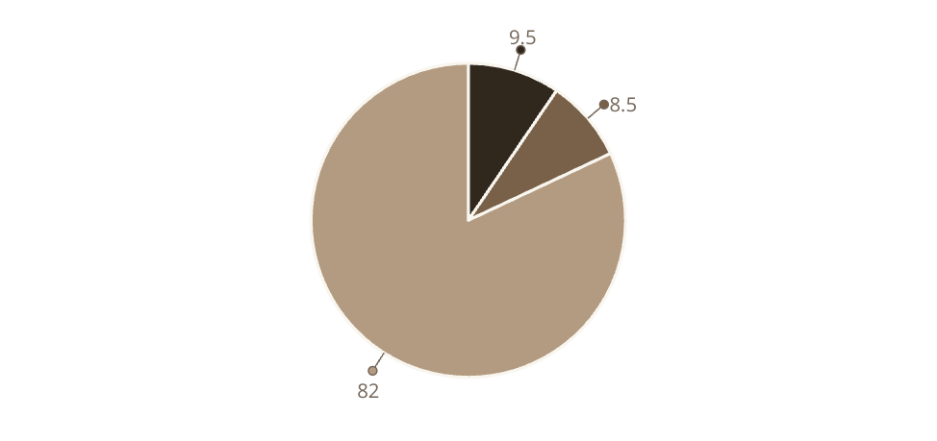
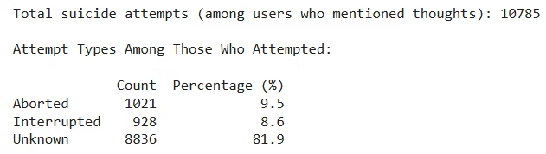
Aborted and Interrupted attempts out of total
attempts
Aborted
Interrupted
Other Attempts

Slide 16
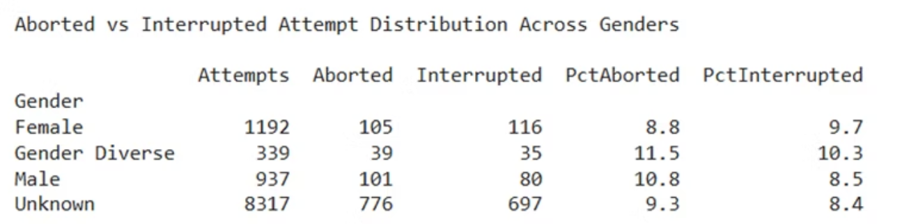
Aborted and interrupted attempts pattern across Gender
Gender-diverse
Key Finding
11.5% of attempts were self-aborted (highest)
Attempt dynamics differ by gender: gender‐diverse individuals more frequently call off their own attempts, and males more often have their attempts externally interrupted.

Slide 17



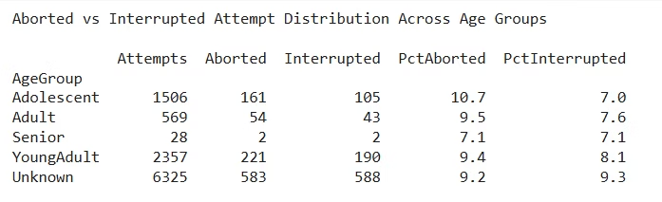
Aborted and interrupted attempts pattern across Age Groups
Adolescents
Young Adults
Adults
Most likely to self-abort attempts among sizeable groups
Moderate self-abort rates
Lower self-abort rates

Slide 18










Dominant Suicidal or NSSI methods
Cutting
Overdose
20.5% of all method mentions
22.4% of all method mentions
Hanging
10.3% of all method mentions
Jumping
8.1% of all method mentions
Firearms
10.0% of all method mentions
User scope: 78515 users expressed suicidal/NSSI thoughts; 30335 (38.6%) of them named ≥1 specific method (total methods
mentions = 44438).
- Dominant methods: Overdose (22.4%) and cutting (20.5%) together comprise ~43% of all method mentions.
- Lethal‐intent methods: Hanging (10.3%), firearms (10.0%) and jumping (8.1%) account for a further ~28%.

Slide 19
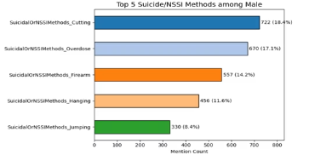
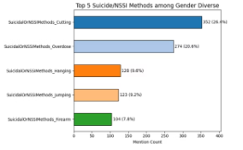
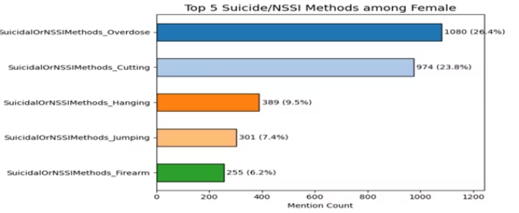
Suicidal or NSSI methods Across Gender
Females
Cutting and overdose are leading methods
Males
Show a stronger firearm component, with cutting and overdose still common
Gender-diverse
Report relatively more hanging, with cutting and overdose still leading
while cutting and overdose are universal leading methods, males show a stronger firearm component, and gender-diverse
users report relatively more Hanging.

Slide 20




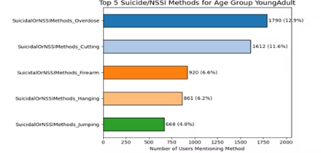
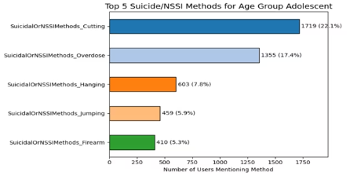
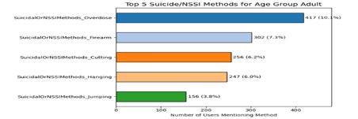
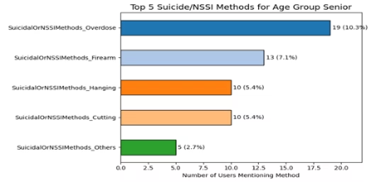
Suicidal or NSSI methods Across Age Groups
Adolescents (11-17)
Young Adults (18-30)
Adults (31-50)
Seniors (50+)
Cutting peaks in this age group
Overdose becomes the dominant
method
Overdose remains dominant
Overdose continues to be dominant
Jumping appears mainly in this
group
Jumping still appears in this
group
Firearms gain relative
prominence
Firearms maintain prominence

Slide 21
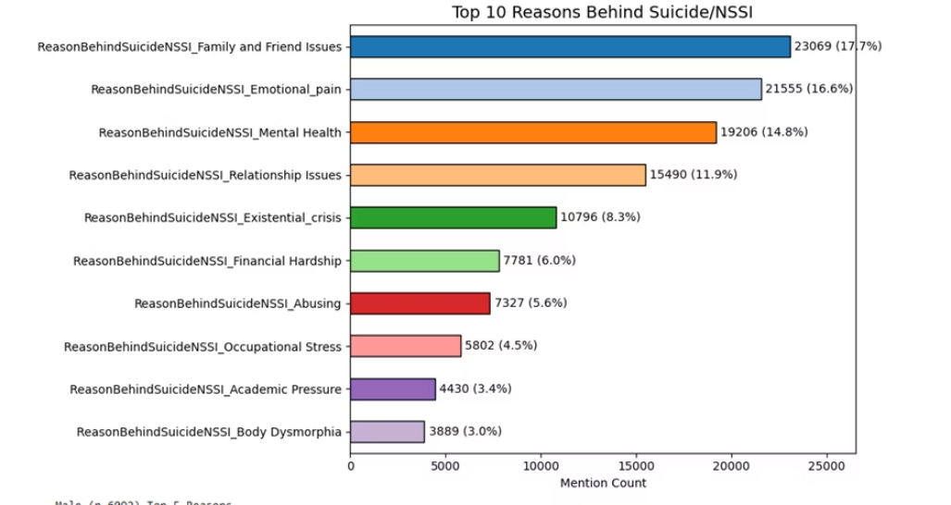
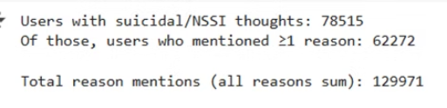
Dominant Reasons behind Suicidal thoughts
17.7%
16.6%
Family & Friends Issues
Emotional Pain
Leading driver across all genders
More prevalent for females (16.4%) than males
(14.0%) or gender-diverse (10.4%)
62272 out of 78515 users (≈80%) named
at least one reason

Slide 22
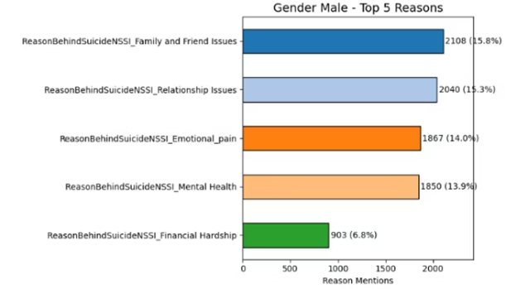
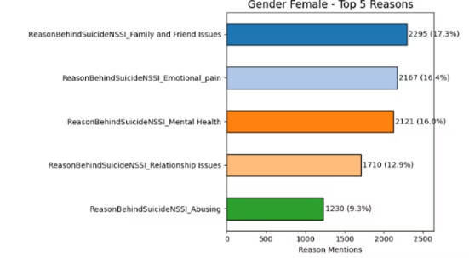
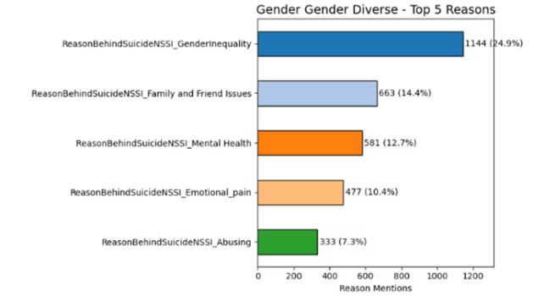
Reasons Behind Suicide Across Gender
Family & Friend Issues
Emotional Pain
Leading driver across all gender identities, ranking #1 for females (17.3%) and males (15.8%), and #2 for gender-diverse users (14.4%).
More prevalent among females (16.4%) compared to males (14.0%)
and gender-diverse individuals (10.4%).
Gender Inequality
Uniquely cited by gender-diverse users as a significant factor
in suicidal ideation.

Slide 23
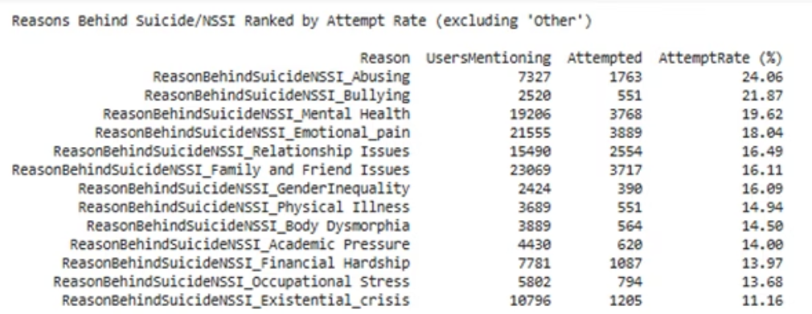
Reasons Behind Suicide Ranked by Attempt Rate
While family issues remain the most commonly cited reason, certain triggers carry disproportionately higher risks of actual suicide attempts.
Abuse-related suicidal thoughts translate to attempts in nearly 1 of 4 cases. Bullying follows closely at 21%. Family issues affect more people but have a lower conversion rate.

Slide 24
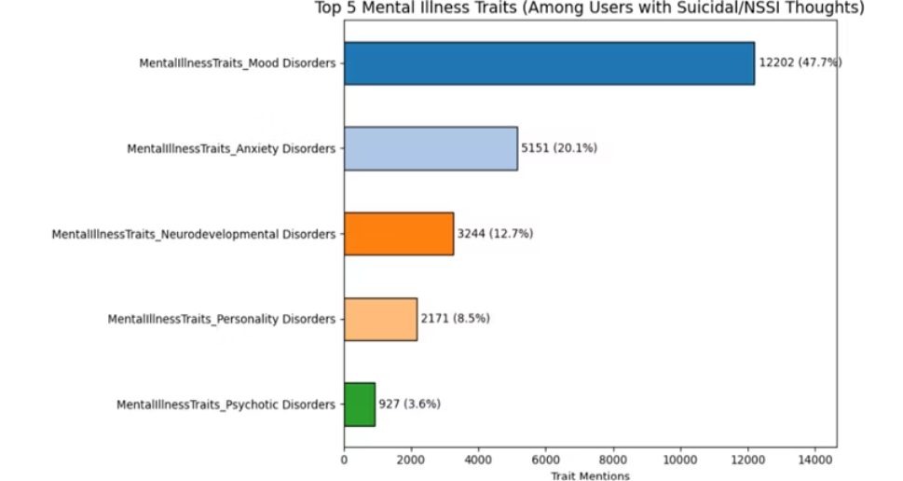
Dominant Mental Illness traits across all users
DSM-5 Categorization
Key Finding
Here, we are using the DSM-5 instrument to categorize the Mental illness traits
Mood and anxiety disorders together represent around three-quarters (68%) of all mental-illness traits cited by users with suicidal/NSSI thoughts.

Slide 25
Mental Illness Categories
The analysis identified 14 DSM-5 based mental illness categories among Reddit users, with mood and anxiety disorders being the most
prevalent
Mood Disorders
Anxiety Disorders
Obsessive-Compulsive and Related Disorders
Trauma and Stressor-Related Disorders
Psychotic Disorders
Eating Disorders
Personality Disorders
Neurodevelopmental Disorders
Substance-Related and Addictive Disorders
Somatic Symptom and Related Disorders
Sexual Dysfunctions
Sleep-Wake Disorders
Neurocognitive Disorders
Other Mental Health Disorders

Slide 26



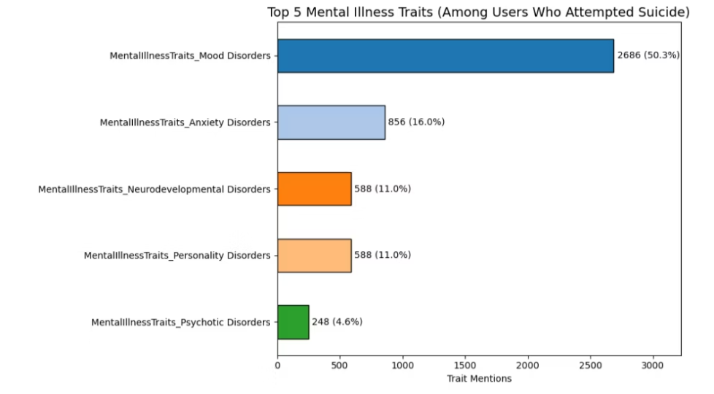
Dominant Mental Illness Traits Among Users Who Attempted Suicide
Mood Disorders
Anxiety Disorders
Other Mental Health Disorders
50.3% of all traits mentions
16.0% of mentions
Remaining 33.7% of mentions
The data clearly shows that mood disorders dominate among attempters, accounting for over half of all trait mentions. Anxiety disorders are the second most cited, representing 16% of mentions. These findings highlight the critical importance of addressing mood and anxiety disorders in suicide prevention efforts.

Slide 27
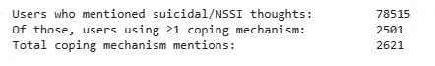
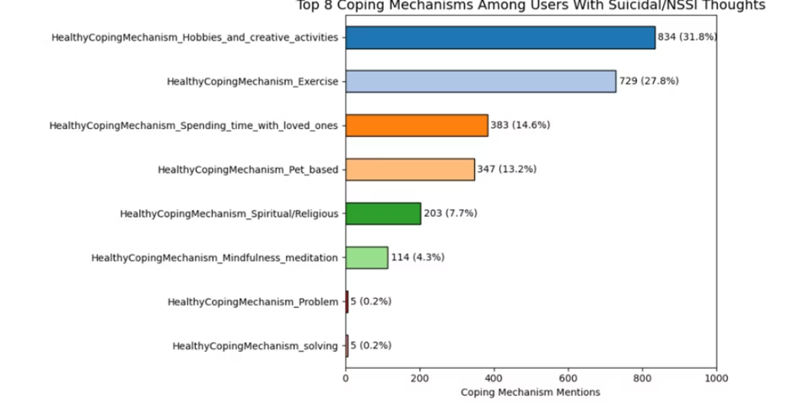
Healthy Coping Mechanisms used by users
2501 of 78515 users reported at least one healthy coping mechanism. Hobbies and creative activities is the most used coping mechanism among Reddit users expressing suicidal or self-harm thoughts.

Slide 28



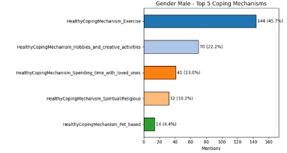

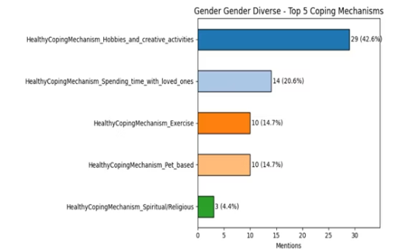
Coping Mechanisms across Genders
Male Users
Strongly lean toward physical coping (exercise), with less diversity in coping styles compared to female users.
Female Users
Display a balanced coping strategy, combining creative, physical, emotional, and spiritual approaches.
Gender Diverse Individuals
Heavily favor creative outlets and emotional connections with loved ones. Spirituality appears less prevalent among this group.

Slide 29




Coping mechanism across Age Group
Adolescents
Young Adults
Prefer social and creative coping mechanisms
Show the highest volume of coping strategies and prefer physically and creatively engaging methods. Their coping is relatively well-balanced across options.
Older Adults
Adults
Tend to rely more on spiritual and
reflective coping mechanisms
Prioritize physical and solo activities. Emotional support (e.g., family, pets) plays a less significant role compared to younger groups.

Slide 30
Users seeking Treatment mechanisms
16.8%
3.2%
Seek Treatment
Use Coping
13213 of 78515 ideators report seeking any formal treatment
Only a small percentage use coping mechanisms
1.1%
58.1%
Use Both
Therapy/Counseling
Very few engage in both treatment and coping
Dominates treatment mentions
Coping vs. treatment: only 3.2% use a coping mechanism, 16.8% seek treatment, but only 1.1% engage in both- suggesting many rely on one or the other.

Slide 31
Emotion Analysis
User Selection Summary
Minimum Activity Threshold: We selected users with a minimum of five distinct timestamps to ensure sufficient emotional progression data.
Number of users with min 5 rows: 10932
Present-Focused Coping Filter: From the dataset, we further filtered users who exhibited present-focused coping mechanisms based on their reported strategies.
Users with at least 5 timestamps among them: 1,403

Slide 32
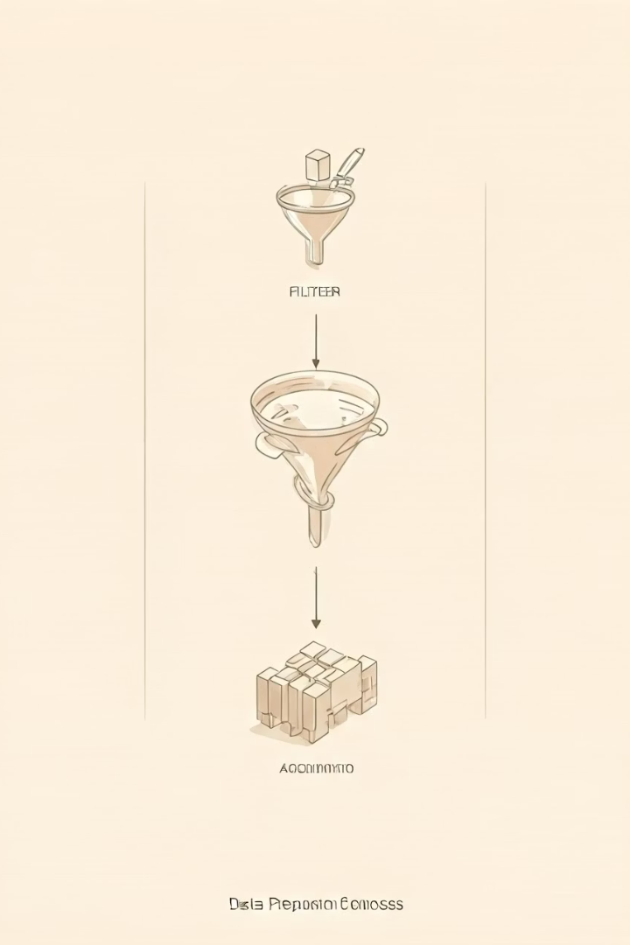
Data Preparation Process
Initial Data Selection
The EmotionalScore field was parsed and split into five distinct emotion columns: joy, sadness, anger, fear, and disgust.
The surprise emotion was excluded from further analysis due to its limited interpretability in this context.
Inconsistent or malformed EmotionalScore entries were identified and removed to ensure data quality.
After filtering, 1,402 users with a minimum of five distinct timestamps were retained for initial analysis.

Slide 33
Data Aggregation
For users with multiple entries on the same date, emotion scores were averaged per day to ensure each timestamp was uniquely represented.
This aggregation reduced the dataset to 657 users, each with at least five unique daily emotion scores, enabling reliable longitudinal analysis.
Emotion Change Calculation
For each user and each emotion, we calculated the change between consecutive timestamps, resulting in new features:sadness_change, joy_change, anger_change, fear_change, disgust_change.
These change metrics were used to analyze emotional variability and instability over time

Slide 34
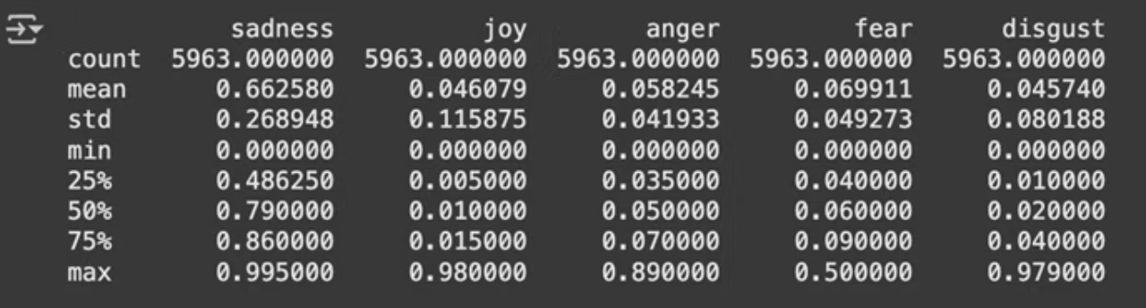
Distribution of Emotions
Sadness is the most dominant emotion with a high average score (mean ≈ 0.66) and relatively low variance.
Joy and disgust have the lowest mean scores (≈ 0.046 and ≈ 0.046, respectively), indicating low presence across the dataset.
Anger and fear show moderate presence with means around 0.06–0.07.
All emotions show a wide range from 0.0 to ~1.0, suggesting high emotional variability among users

Slide 35
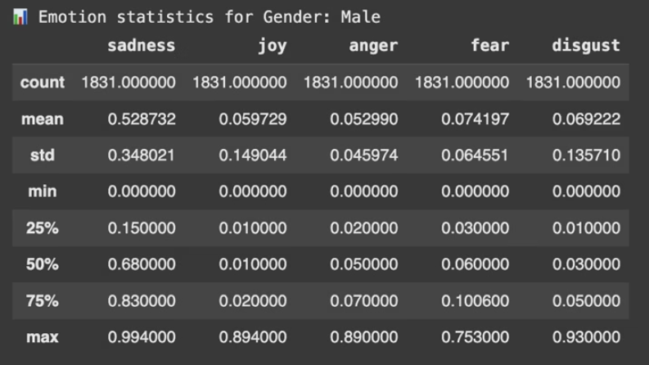
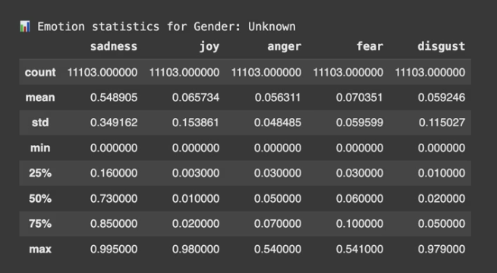
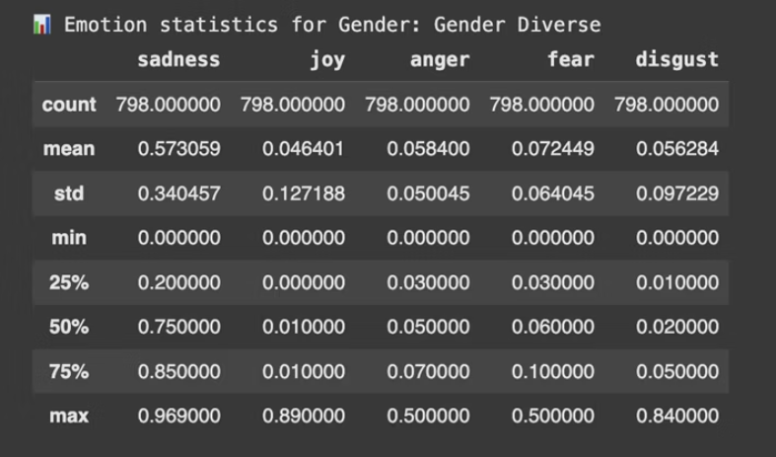
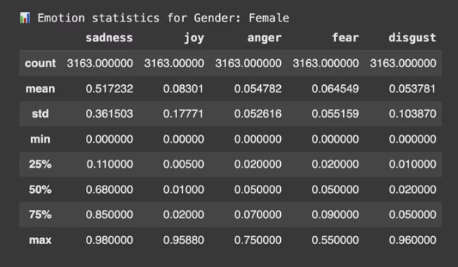
Emotion Distribution Across Gender

Slide 36
Sadness is highest among Gender Diverse users (mean ≈ 0.573), closely followed by Unknown and Male groups, indicating a strong emotional burden in this population.
Joy is highest in Female users (mean ≈ 0.083), suggesting they express slightly more positivity compared to others; Gender Diverse and Male users report the lowest joy levels.
Disgust levels are notably high in Male users (mean ≈ 0.069) with a wide range (max up to 0.93), pointing toward stronger expressions of aversion or frustration.
Gender Diverse users show the highest emotional intensity spread across all emotions — moderately high sadness, low joy, and balanced fear/anger — reflecting potential internal conflict and emotional volatility.

Slide 37
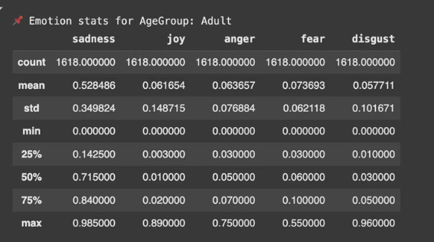
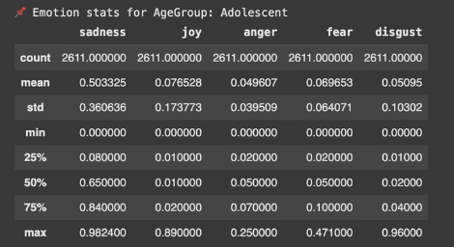
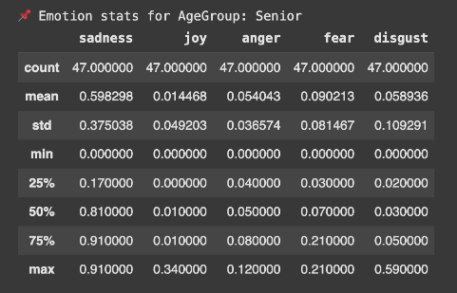
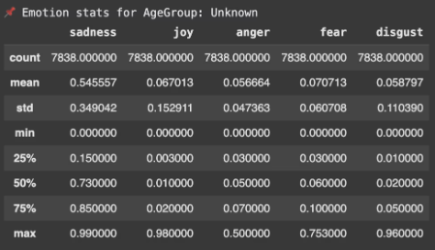
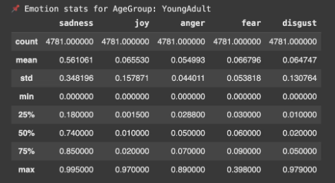
Emotion Distribution Across Age Groups

Slide 38
Seniors show the highest average sadness (≈ 0.598) among all age groups, with a median of 0.81—indicating a strong tendency toward persistent negative affect in older users.
Adolescents express the highest average joy (≈ 0.077) across age groups, while Seniors report the lowest joy (≈ 0.014), highlighting generational differences in positive emotional expression.
Adults display the highest anger levels (mean ≈ 0.064), followed closely by Seniors and Young Adults, suggesting mid-life users may experience more emotional agitation.
Fear is highest among Seniors (mean ≈ 0.090), possibly reflecting health-related anxieties or vulnerability, followed by Adults (≈ 0.074) and Adolescents.

Slide 39


Emotion Change Metrics
Increase/Decrease Metrics
Ratio Calculations
Emotion Outcome Classification
For each emotion (sadness, joy, anger, fear, disgust), we calculated:
Sadness_inc_ratio: Proportion of timestamps where sadness score increased relative to total comparisons.
Each user was assigned an emotional outcome — Improved, Declined, or Neutral — based on the overall trend in their emotional scores across timestamps.
_inc / _dec / _same: Number of times the emotion increased, decreased, or stayed the same across timestamps (e.g., sadness_inc).
Sadness_dec_ratio: Proportion of timestamps where sadness score decreased relative to total comparisons
_inc_ratio / _dec_ratio: Proportion of increases or decreases relative to total observations.

Slide 40

Coping Mechanisms Analysis
We examined the distribution of healthy coping strategies among users labeled as Improved and Declined based on emotional outcomes.
Note: A single user may employ multiple coping mechanisms — in such cases, they are counted under each relevant category.
Top mechanisms among improved users include:
Spending_time_with_loved_ones (4 users improved vs. 1 declined)
Pet_based and Hobbies_and_creative_activities also showed balanced or positive association.
Exercise and Spiritual/Religious coping appeared only among improved users — a possible indicator of their positive influence.

Slide 41

Treatment Mechanisms Analysis
65%
35%
Improved Users
Declined Users
Percentage of users showing improvement with treatment
Percentage of users showing decline despite treatment
42%
Multiple Treatments
Users employing more than one treatment approach
Users with multiple treatment types were counted under each relevant category. This highlights which treatments are more commonly associated with improved or declined emotional outcomes.

Slide 42





Gender and Age-Based Analysis
Gender-wise Coping Mechanisms
Analysis of which coping mechanisms improved or declined user emotions based on gender
Age-group Coping Mechanisms
Analysis of which coping mechanisms improved or declined user emotions based on age groups
Gender-wise Treatment Mechanisms
Analysis of which treatment mechanisms improved or declined user emotions based on gender
Age-group Treatment Mechanisms
Analysis of which treatment mechanisms improved or declined user emotions based on age groups

Slide 43




Gender-wise Coping Mechanisms
Unknown Gender users showed the widest variety of coping strategies, with Spending time with loved ones linked to more improvements (4 improved vs 1 declined).
Female Users benefited most from Spiritual/Religious coping (1 improved, 0 declined), while Hobbies showed a decline.
Male Users mostly reported None as a coping mechanism, with mixed emotional outcomes (2 improved vs 1 declined).
Gender Diverse users had no recorded healthy coping mechanism data, indicating missing or unreported strategies.

Slide 44




Age-group Coping Mechanisms
Adolescents showed the most diverse and effective coping patterns—Hobbies/Creativity and Spending time with loved ones were each linked to 2 improvements and 0 declines.
Young Adults reported mostly neutral or negative outcomes; Hobbies, Pet-based, and Loved ones coping were all associated only with declines.
Adults and Seniors had limited coping data, with no recorded improvements for any coping strategy, indicating possible reporting gaps or ineffective coping.
Users with Unknown Age showed better outcomes with Spending time with loved ones (2 improved, 0 declined) and Exercise (1 improved, 0 declined).

Slide 45

Gender-wise Treatment Mechanisms
Gender Diverse users reported no treatment data, indicating a gap in either reporting or sample representation.
Users with Unknown Gender had the most treatment diversity, with Therapy/Counseling and Prescribed Medication each linked to 4–5 improvements and similar declines.
Female users benefited more from Prescribed Medication (3 improved vs. 1 declined), while Therapy showed equal counts for improvement and decline.
Male users had relatively balanced outcomes across all treatment types, each showing 1 improvement and 1 decline, suggesting mixed effectiveness or small sample size.

Slide 46

Age-group Treatment Mechanisms
Young Adults had the highest total treatment engagement, but improvements and declines were nearly equal across all methods—indicating mixed effectiveness.
Adolescents showed slightly better improvement with Prescribed Medication (2 improved vs. 1 declined), but Therapy/Counseling was less effective (1 improved vs. 2 declined).
Adults reported only minor treatment data, with both None and Therapy/Counseling linked to a single improvement and no declines.
Seniors had no recorded treatment mechanism data, possibly due to underrepresentation or missing information in that age group.

Slide 47






Emotional Instability Analysis
Instability Calculation
Total Emotion Instability
Mental Illness Correlation
Emotion Instability Calculation: Instability for each emotion was calculated as the proportion of change (increase + decrease) over total observations (including unchanged states), with a small epsilon added to avoid division by zero.
Total Instability Metric: A combined instability score was computed across all emotions by aggregating the increase and decrease counts relative to total observations per user.

Slide 48

Mental Illness Correlation
Anxiety Disorders Show Significance: Users with Anxiety Disorders had significantly lower emotional stability compared to those without, supported by a p-value of 0.02048, marking it statistically significant.
No Significant Instability in Other Traits: While traits like Personality and Mood Disorders had high instability scores, none except Anxiety Disorders crossed the statistical significance threshold (p < 0.05).

Slide 49


Regression Model for Score
Score: Net Upvote - Downvote
Here we are finding out which variables are significant to generate higher score on the post
T- test result for Binary variables with Score
Pearson test for Numeric Veriable Number of Comments with Score
An r = 0.685 indicates a strong positive correlation between the number of comments a post receives and its score (net upvotes minus downvotes).

Slide 50


Regression Model for Score
VIF Test Results
No Multicollinearity observed
Linear Regression Model
Key Predictors
R-squared: 0.476 — the model explains ~47.6% of the variance in the post Score.
NumComments and Sentiment_Positive are the strongest
predictors of higher post scores.
F-statistic (1.267e+04), p ≈ 0.00 — the overall model is highly
significant.

Slide 51

Regression Model for Score
Statistically significant variables
Staitically insignificant Variables

Slide 52


Evolution of User Emotions Over Time
We can see some improvements in the sadness over a period of time as user is considering positive coping mechanism

Slide 53


Evolution of User Emotions Over Time
• As a result of Not considering any coping mechanism/treatment, we can see the increase in the Emotion trajectory for Sadness over time.

